Slide 1
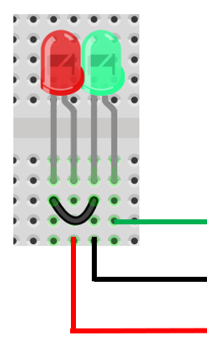
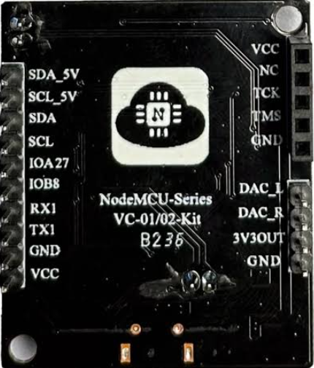
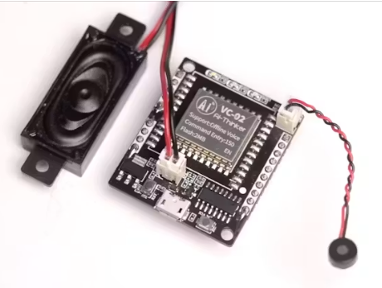
VC-02-Kit AI Intelligent Offline Voice Recognition Control Module Development Board
VC-02-Kit – STANDALONE APPLICATION

Slide 2
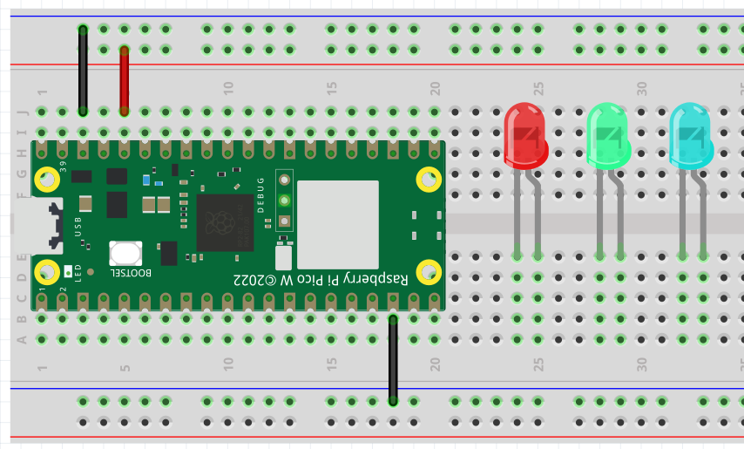
VC-02-Kit AI Intelligent Offline Voice Recognition Control Module Development Board
VC-02-Kit – EDGE AND HUB APPLICATION

Slide 3
VC-02-Kit – DEMO #1 – STAND-ALONE APPLICATION

Slide 4

VC-02 STAND-ALONE
WIRING DIAGRAM
GND
TX1
IOA27

Slide 5
VC-02-Kit – DEMO #1 – HOW TO CREATE THE FIRMWARE

Slide 6
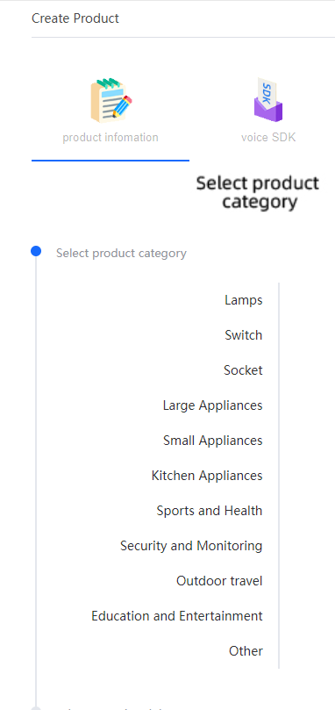



http://voice.ai-thinker.com
Register for an account

Slide 7
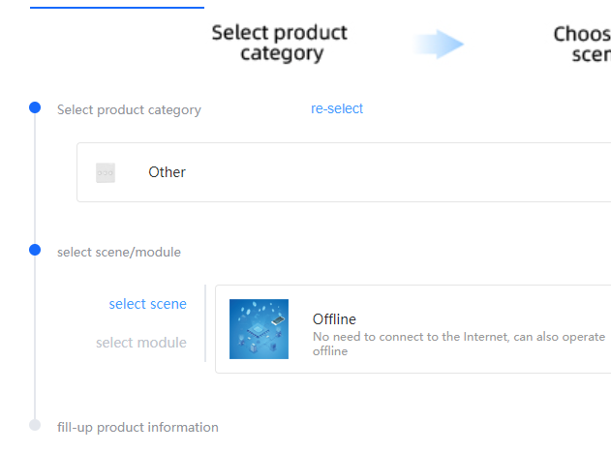
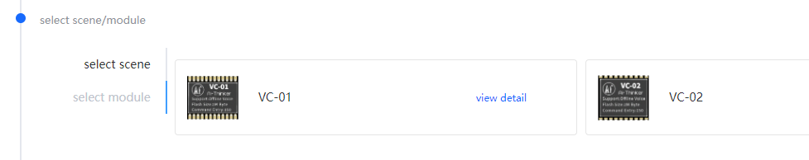

Slide 8
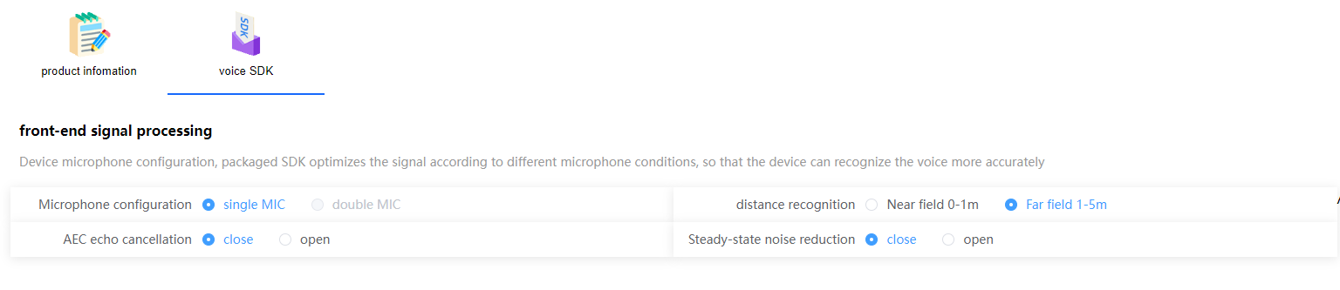
Leave them as default

Slide 9
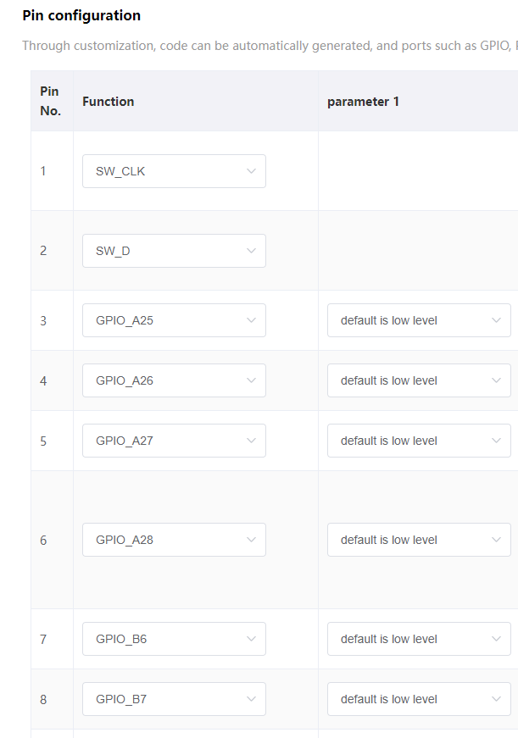
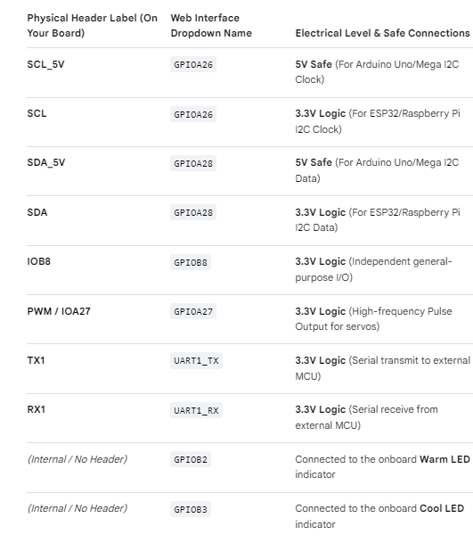
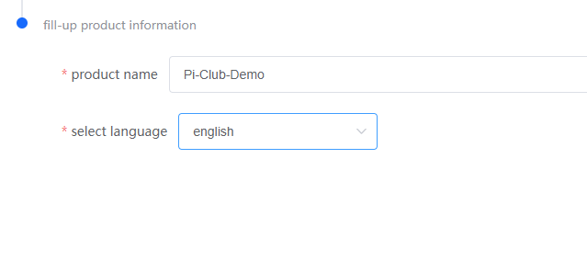



Slide 10
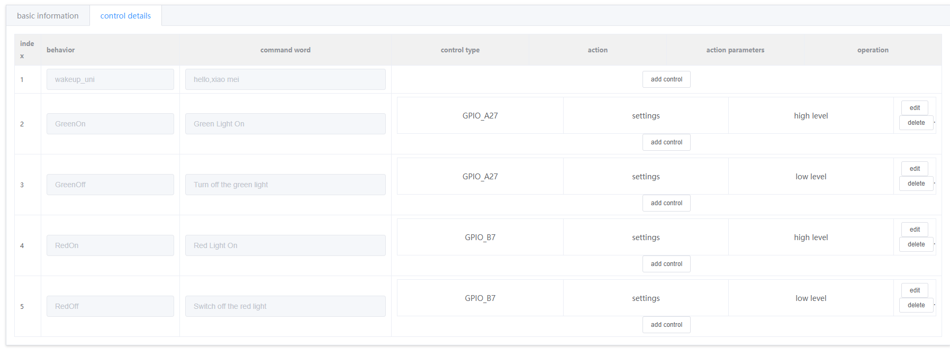
Pins on the VC02
Pins on the Web
OUR DEMO : Physical vs Web
IOA27
GREEN LED
IOA27
TX1
RED LED
TX1

Slide 11
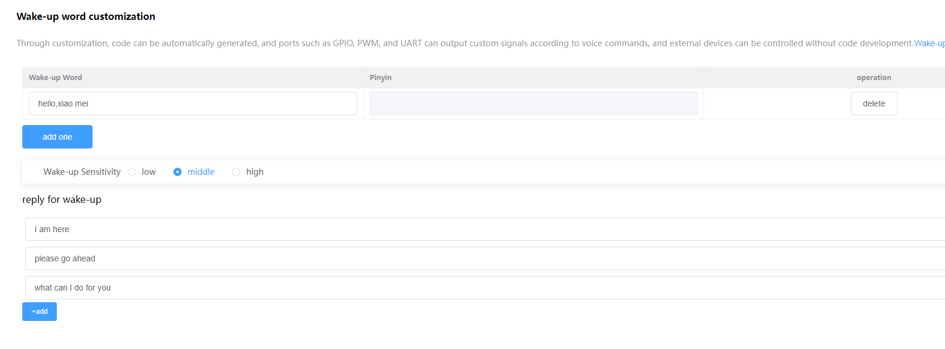
Leave them as default

Slide 12
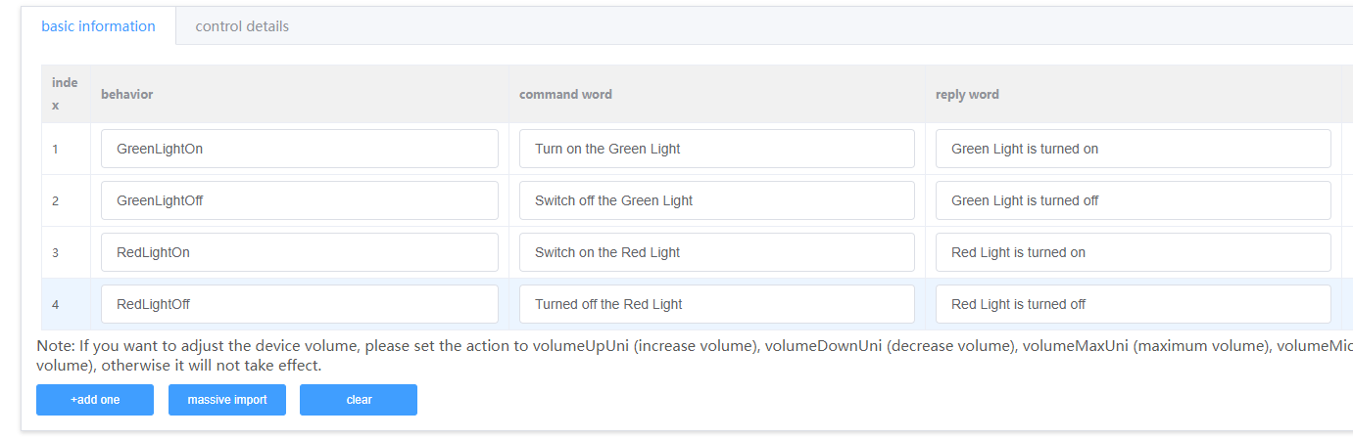
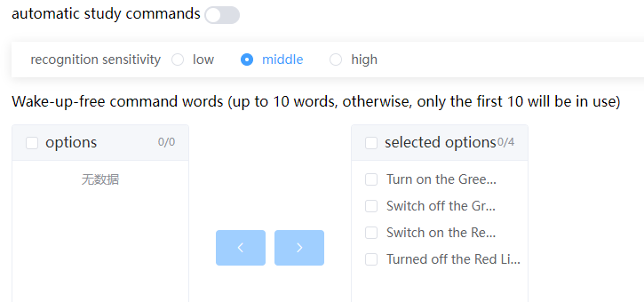
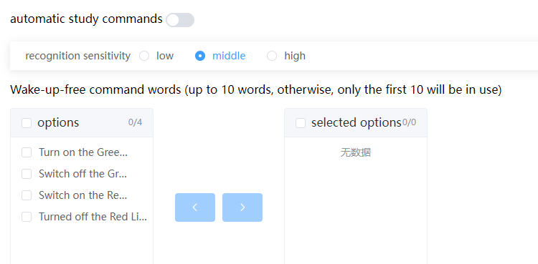

Slide 13
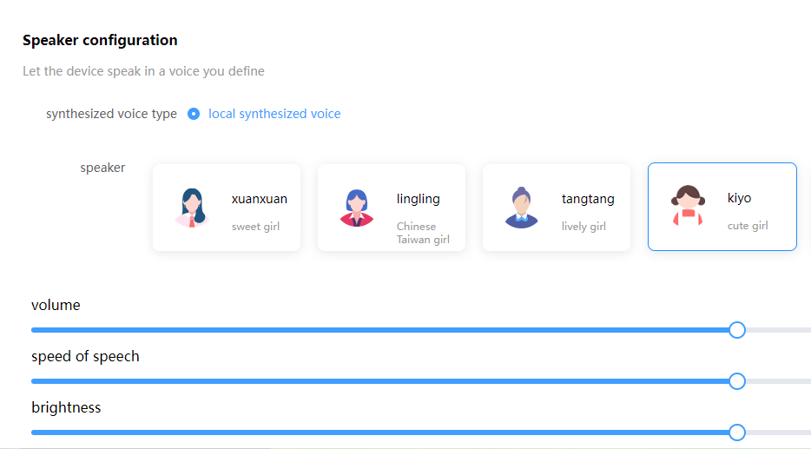

Slide 14
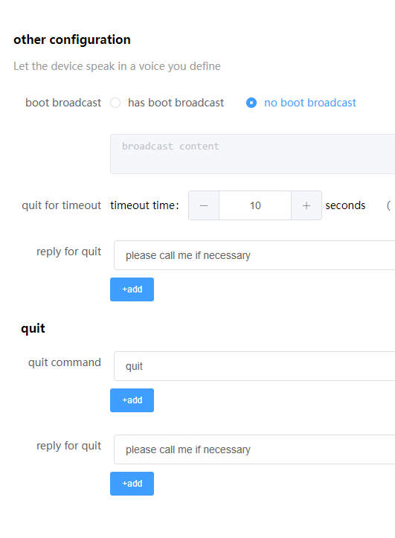


Slide 15
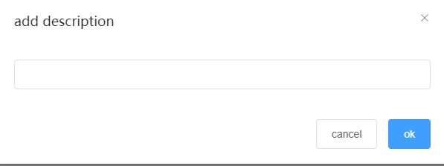
Light Control

Slide 16

When you see this screen,
Scroll the mouse upwards

Slide 17
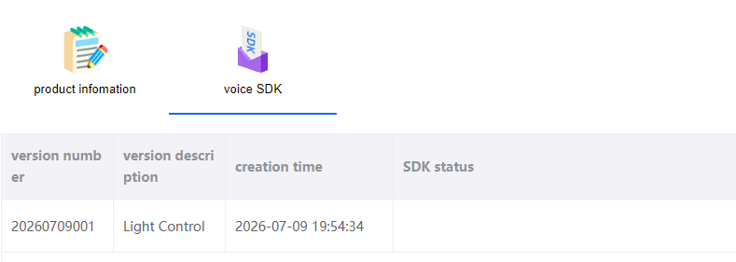



May take an hour + sometimes
Click

Slide 18




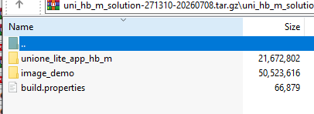
Double click this
Double click this
Select image_demo

Slide 19
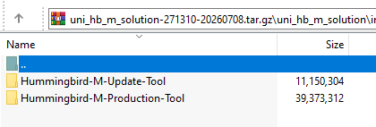
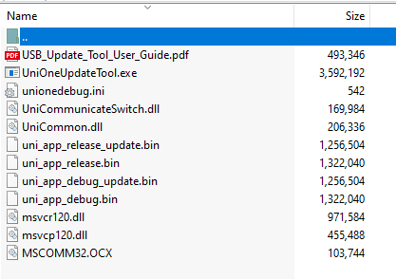
Select Hummingbird-M-Update-Tool
Select UniOneUpdateTool.exe

Slide 20
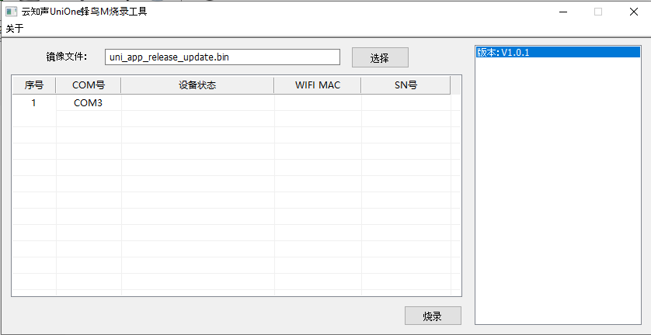


Once the COM3 row is highlighted. Press the RST Button on the VC-02
Click this. It means Flash Firmware

Slide 21
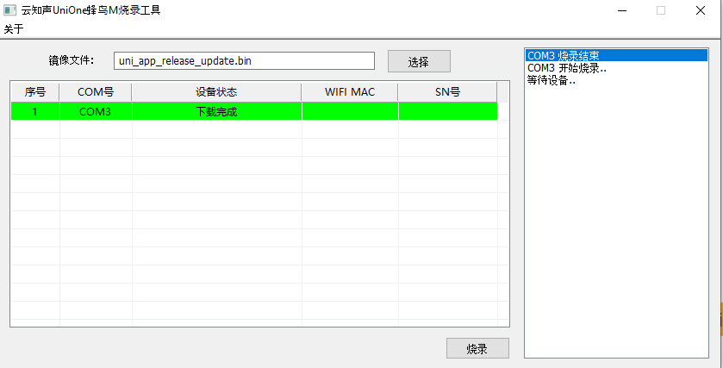
This means the firmware flashing is completed.
You can now interact with the VC-02 using the commands
you have created

Slide 22
VC-02-Kit – DEMO #2 – HOW TO CREATE THE FIRMWARE FOR SERIAL COMMUNICATIONS WITH MICROCONTROLLERS

Slide 23
VC-02-Kit AI Intelligent Offline Voice Recognition Control Module Development Board
VC-02-Kit – EDGE AND HUB APPLICATION

Slide 24



VC-02 STAND-ALONE AS EDGE
PICO W AS BRAIN & HUB
VC-02
SERIAL CONNECTION
VC-02 TO PICO W
tx rx

Slide 25
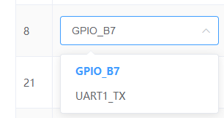
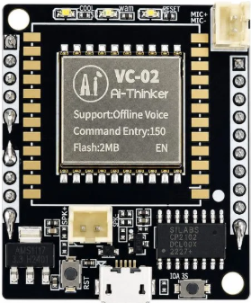

USING UART – SERIAL COMMS
VC02 <> Microcontroller (Pico)
Serial Comm

Slide 26
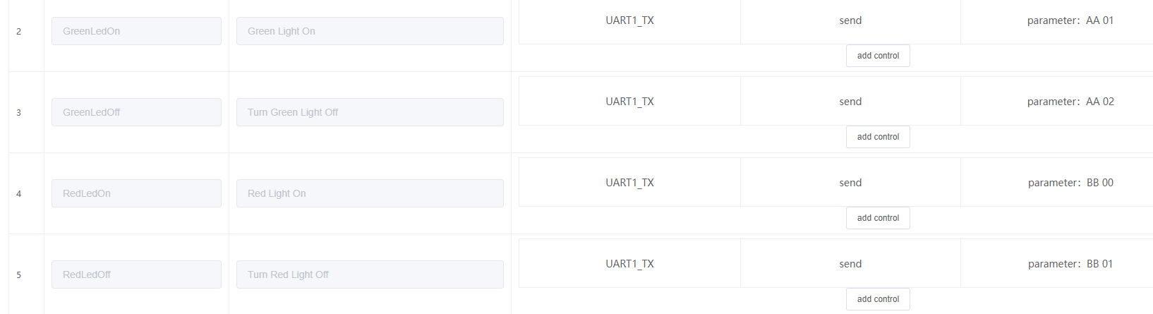
Breakout to demo on Web

